Slide 1
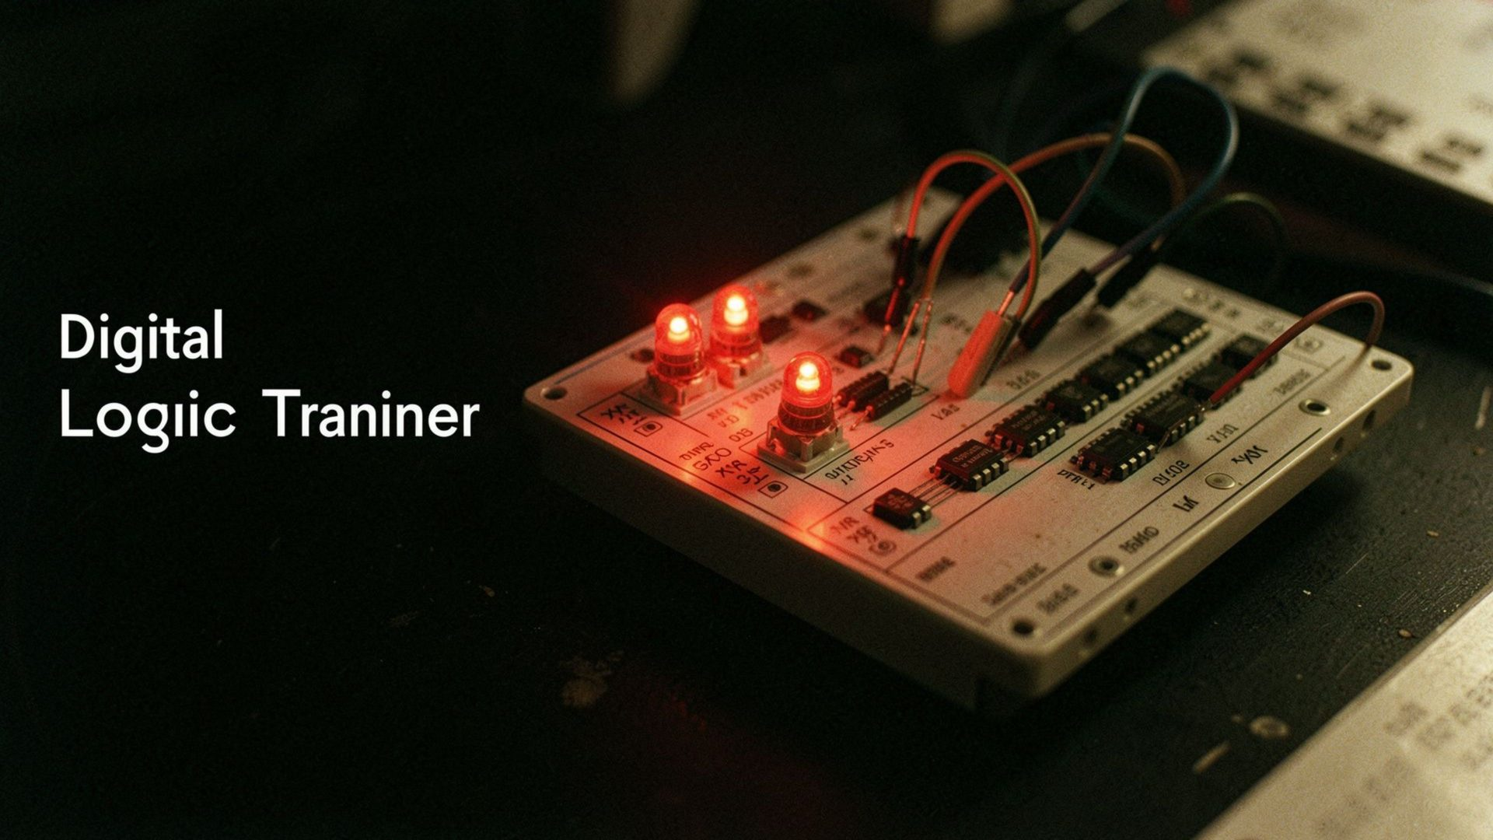
DDCA PROJECT
Srijan — 2620030689
Sahasra — 2620030611
Nayani — 2620040007
Yagnesh — 2620040014
Aditya — 2620040025
DIGITAL ERROR DETECTION SYSTEM USING PARITY
Section: 14 | Batch: 11

Slide 2



DDCA PROJECT
Introduction & Objective
What is Error Detection?
What is Parity?
Objective
Error detection is the process of identifying whether data has changed during digital data transmission. Errors may occur due to noise or interference in the communication channel.
Parity is a simple error-detection technique that adds an extra bit, called a parity bit, to the original data.
To design and simulate a digital circuit that detects transmission errors using an even parity bit and XOR gates.
02 / 09

Slide 3
Parity & XOR Concept
XOR Truth Table
Types of Parity
A | B | A ⊕ B
0 | 0 | 0
0 | 1 | 1
1 | 0 | 1
1 | 1 | 0
Even Parity: The total number of 1s in the data, including the parity bit, must be even.
Odd Parity: The total number of 1s in the data, including the parity bit, must be odd.
Example
Why XOR Gates?
Data: 1011
Number of 1s: 3 (odd)
Even parity bit: 1
Transmitted data: 10111
Total number of 1s: 4 (even)
XOR gates are used because their combined output indicates whether the number of 1s is odd or even.
03 / 09

Slide 4
System Design / Block Diagram
Working Flow
4-bit Input Data
Parity Generator
Data + Parity Bit
Transmission
Parity Checker
Error / No Error
Main Blocks
1. Parity Generator
2. Transmission Channel
3. Parity Checker
Calculates the parity bit for the original 4-bit data.
Carries the data and parity bit to the receiver. A bit may change during transmission.
Checks the received bits and produces an output indicating whether an error is detected.
04 / 09

Slide 5
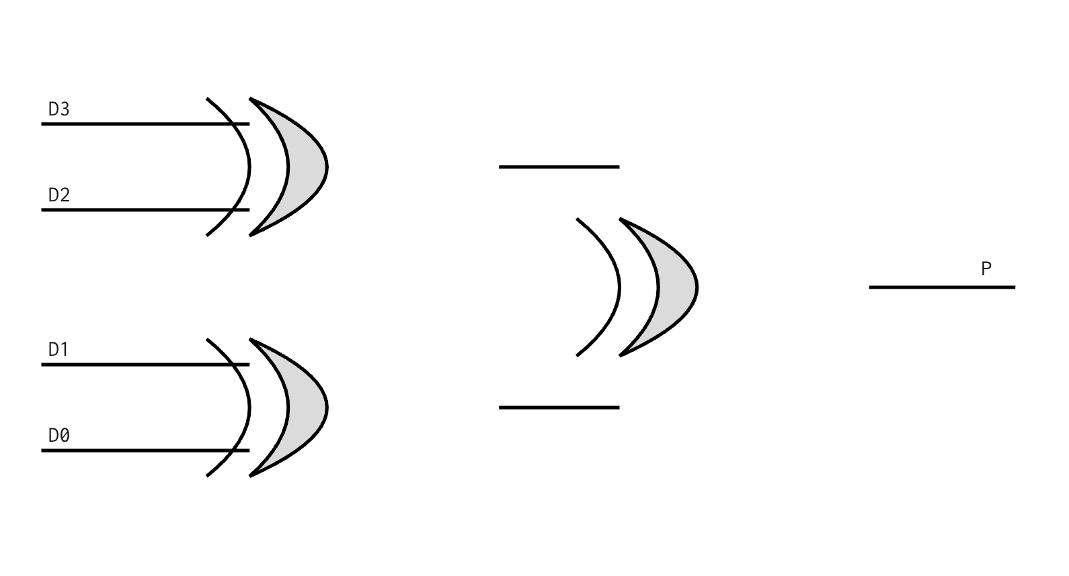
Parity Generator
Input
Four data bits: D3 D2 D1 D0
Even Parity Equation
P = D3 ⊕ D2 ⊕ D1 ⊕ D0
The parity generator uses XOR gates to calculate the parity bit. The bit is selected so that the total number of 1s, including the parity bit, is even.
The generator can be implemented using three 2-input XOR gates in Logisim.
Example
Data = 1011 → P = 1 ⊕ 0 ⊕ 1 ⊕ 1 = 1
Original data: 1011
Parity bit: 1 | Transmitted data: 10111
05 / 09

Slide 6
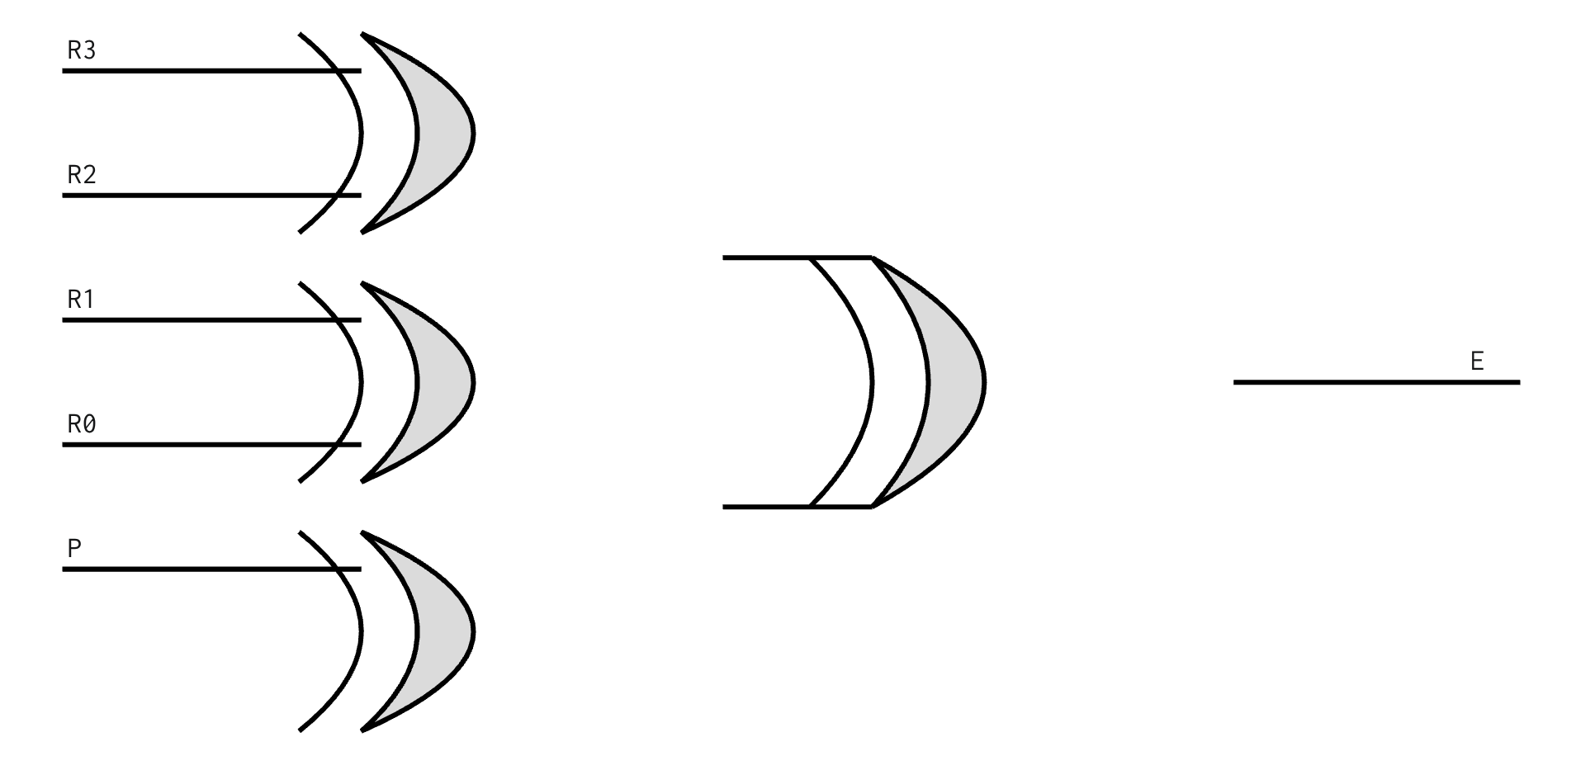
Parity Checker
The parity checker receives the four data bits and the parity bit, then checks whether the total number of 1s is even.
Error Detection Equation
E = R3 ⊕ R2 ⊕ R1 ⊕ R0 ⊕ P
R3, R2, R1, R0 are the received data bits.
P is the received parity bit.
E is the error indicator.
Output Interpretation
Example
E = 0: No error detected.
E = 1: Error detected.
Received data with parity: 10111
E = 1 ⊕ 0 ⊕ 1 ⊕ 1 ⊕ 1 = 0 → No error detected.
If a single bit changes, the XOR result becomes 1, indicating an error.
06 / 09

Slide 7
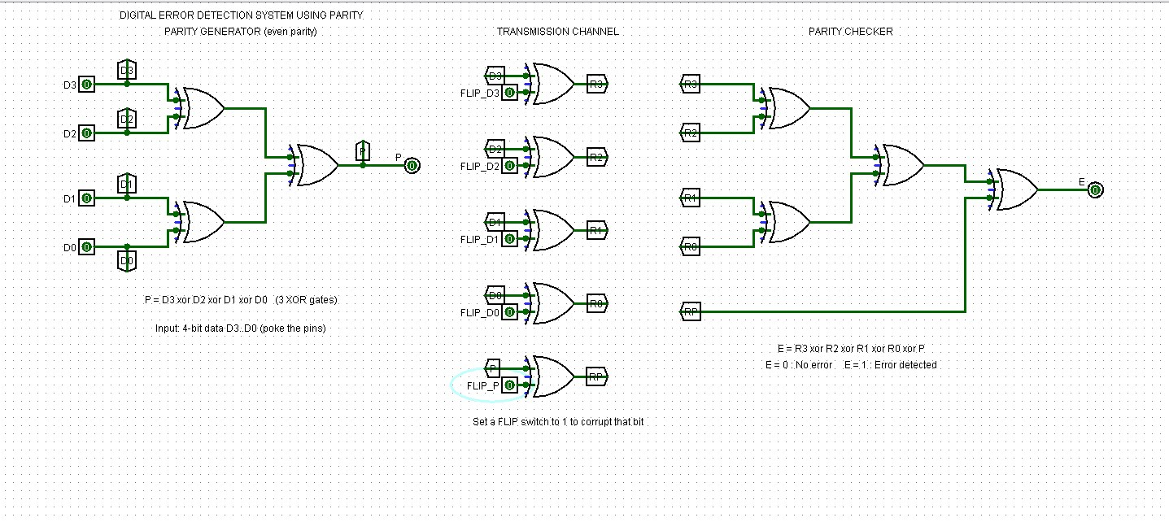
PRACTICAL BUILD
Logisim Implementation & Testing
Test Cases
Received | Output | Result
10111 | 0 | No error
11000 | 0 | No error
10011 | 1 | Error detected
Observation
When the received bits satisfy the even-parity condition, the checker output is 0. When a single bit changes, the checker output becomes 1.
Components Used
Input pins for the data bits
XOR gates for parity generation and checking
Wires for connections
Output pins or LEDs to display results
07 / 09

Slide 8
FINAL REVIEW
Advantages, Limitations & Conclusion
Advantages
Limitations
Conclusion
Simple and fast error detection.
Requires only a small number of logic gates.
Easy to design and simulate using XOR gates.
Useful for demonstrating basic digital communication concepts.
Detects errors but does not correct them.
An even number of bit changes may go undetected.
Does not identify which bit is incorrect.
The Digital Error Detection System Using Parity demonstrates how XOR gates can generate and check parity bits. The circuit detects errors when the received data violates the even-parity condition. The Logisim simulation helps demonstrate the practical working of this digital logic system.
Team Responsibilities
Member | Slides / Responsibility
Srijan | Slides 1–2: Introduction and objective
Sahasra | Slide 3: Parity and XOR
Nayani | Slides 4–5: System design and generator
Yagnesh | Slide 6: Parity checker
Aditya | Slides 7–8: Logisim testing and conclusion
08 / 09

Slide 9
THANK YOU

